Slide 1
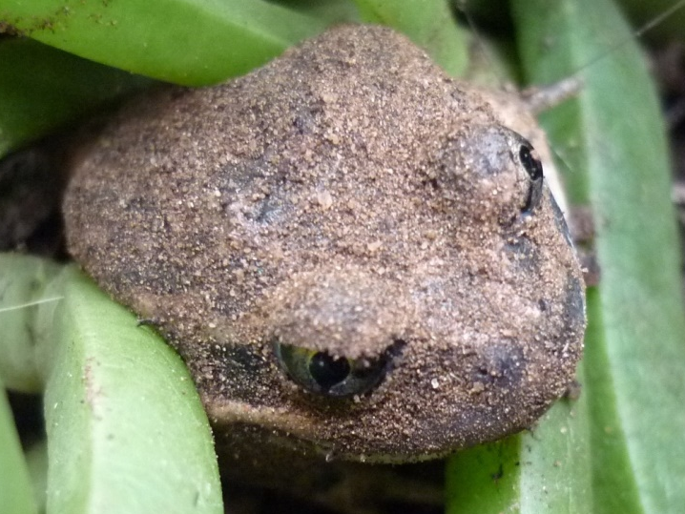


Frogs of the Wimmera
Integrating frog education into your River Detectives Program

Slide 2


Frogs of the Wimmera a PPT PD session for River Detective teachers
This PD is provided as an in-school program to be used at a time that suits teachers.
It covers:
  What is a ‘frog’ ?
  Frog species of the Wimmera
  On being a frog
  Monitoring frogs
  Frog education in River Detectives
  Evaluation response please!
  There is information and resources at different levels to cater for the primary – secondary span of our RD teachers and potential variations in prior knowledge.
  Time spent on this powerpoint PD will thus vary, but a PD certificate will be issued on return of a completed evaluation form. Please indicate in your evaluation which parts of this powerpoint you completed.
  Thankyou … and enjoy!
Professional standards addressed are:
    Professional Knowledge –
    2 Know the content and how to teach it.- 2.1 content and teaching strategies
    Professional Engagement –
    6 Engage in professional learning 6.2 engage in professional learning and improve practice
    7 Engage with colleagues and community 7.4 Engage with professional teaching networks and broader communities.

Slide 3
Frogs of the Wimmera
Integrating frog education into your River Detectives Program
1 What is a ‘frog’?

Slide 4
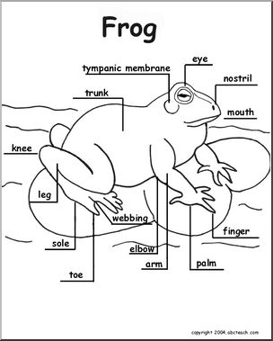
1.1 The parts of a frog’s body
(For full details of the parts of a frog’s body see a website like http://www.flippedoutscience.com/uploads/2/7/8/2/27824091/frog_dissection_instructions.pdf )
Frogs have head parts like humans, except for their ears.
  See diagram, what replaces them?
Frogs have four legs:
  Two (back) hind legs
  Two (front) forelegs.
  See diagram- which legs are longer?
  Forelegs end in hands with fingers.
  Hind legs end in feet with toes.
  See diagram- how many of each?
(n.b. In this ppt., blue italics font indicates an activity for you to do. Answers will be found in the notes box below the slide.)
Source of diagram: https://www.abcteach.com/documents/frog-diagram-labeled-and-unlabled-animals-amphibian-diagram-12041
Notes:
Frogs have tympanic membranes instead of ears.
The hind legs are usually longer.
They have four fingers nad five toes . (They may/not have webbing.)

Slide 5
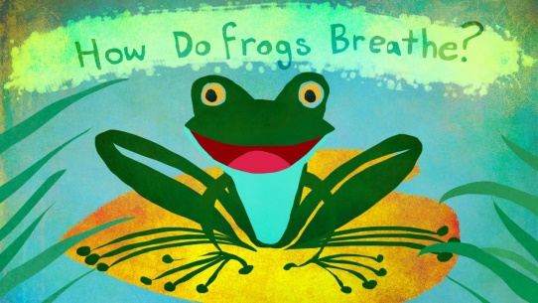
1.2 Frogs are amphibians
Frogs are vertebrates and amphibians.
  Vertebrates have a backbone.
  Amphibian means ‘both life’, as they live on land and water.
    Frogs begin in water as unshelled eggs covered in a jelly substance
    They hatch and grow as tadpoles in water,
    but as adults (frogs), they can live on land as well as in water.
Watch this 3-minute video that defines amphibians and how they breathe:
How Do Frogs Breathe? https://www.youtube.com/watch?v=OwjvABbRjdA
See diagrams and explanations on this webpage https://animalrespriation.weebly.com/frog.html
Frogs are adapted to live in both water and land.
They have a soft moist skin
through which they ‘breathe’ in oxygen in the water
They have nostrils
Through which they ‘breathe’ in oxygen in the air.

Slide 6
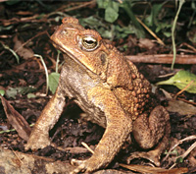
1.3 Frog or Toad?
.
Frogs are the only amphibians native to Australia.
There is only one toad in Australia – the introduced Cane Toad (photo right). Toads, the Bufonidae, are different to frogs by their bone structure.
Cane toads are:
large, stocky amphibians with dry, warty skin
native to the Americas : the southern United States, Central America, and tropical South America.
Cane Toad photo source: Brisbane City Council ‘Cane Toads’ at https://www.brisbane.qld.gov.au/sites/default/files/032754.jpg
Cane toads thrive in Australia because:
they have few natural predators
they breed easily
There is plenty of food, including pet food (stolen from outdoors pet food bowls).
Cane toads outcompete and reduce native species :
As they are poisonous to many native species that eat them (pets and humans too);
As they eat native insectivores, such as skinks, the food for native species is reduced.
Watch the great devastation caused by cane toads in Australia in this 4-minute video https://www.youtube.com/watch?v=oYcl0xxU5_s
Notes:
Changed this page

Slide 7
Frogs of the Wimmera
Integrating frog education into your River Detectives Program
2 Frog species of the Wimmera

Slide 8
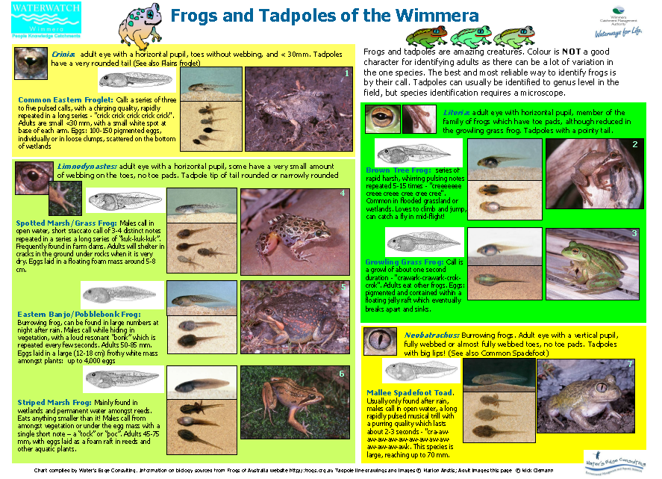
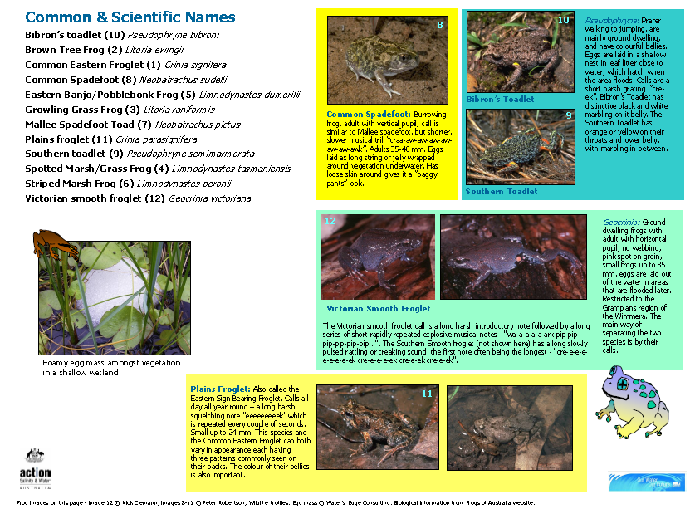
2.1 Wimmera frog/tadpole ID sheets
The Wimmera CMA has class sets of A3 reference sheets to aid the identification of frogs and tadpoles of the Wimmera.
The frogs are split into six groups:
Two have horizontal pupils
  Crinia –no webbing between toes
  Limnodynastes – no toe pads, (some webbing between toes),
Two have vertical pupils
Litoria – toe pads
    Neobatrachus- no toe pads, webbed toes
Two other groups
  walk instead of jump
  Pseudophryne
  ground dwellers
Geocrinia
Copies are available from the Wimmera CMA at https://wcma.vic.gov.au/contact-us or (03) 5382 1544 .

Slide 9
2.2 The fourteen Wimmera frogs
The Wimmera has 14 known frog species:
Common name (Wimmera) | Common name (Frogs of Aust.) | Scientific (Latin) name
Bibron’s Toadlet ** | Bibron’s Toadlet ** | Pseudophryne bibronii
Brown Tree Frog | Southern Brown Tree Frog | Litoria ewingii
Common Eastern Froglet | Eastern Common Froglet | Crinia signifera
Common Spadefoot | Common Spadefoot Toad | Neobatrachus sudelli
Pobblebonk | Eastern Banjo Frog, Pobblebonk | Limnodynastes dumerilii
Growling Grass Frog ** | Growling Grass Frog ** | Litoria raniformis
Mallee Spadefoot Toad | Mallee Spadefoot Toad | Neobatrachus pictus
Plains Froglet | Eastern Sign-bearing Froglet | Crinia parinsignifera
Southern Toadlet * | Southern Toadlet * | Pseudophryne semimarmorata
Spotted Marsh Frog | Spotted Marsh Frog | Limnodynastes tasmaniensis
Striped Marsh Frog | Striped Marsh Frog | Limnodynastes peronii
Victorian Smooth Froglet | Victorian Smooth Froglet | Geocrinia victoriana
Southern Smooth Froglet | Southern Smooth Froglet | Geocrinia laevis
Peron’s Tree Frog | Peron’s Tree Frog | Litoria peronii
* vulnerable in Victoria ** endangered in Victoria
Notes:
Removed the numbers

Slide 10
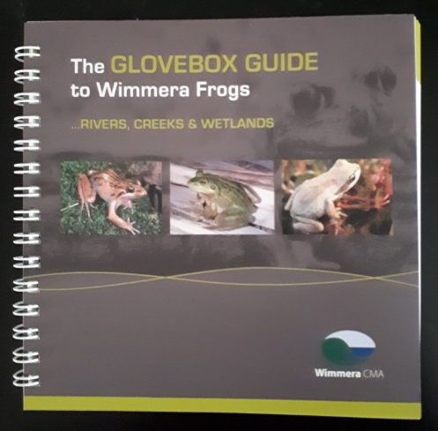
2.3 Frogs of the ‘Wimmera Guide’
Each of the Wimmera’s fourteen known frog species is described in the Wimmera CMA’s “Glovebox Guide to Wetland Frogs” by:
photo,
description
habitat and behaviour
season of occurrence
call sound (on the enclosed DVD).
Copies of this are available from the Wimmera CMA at https://wcma.vic.gov.au/contact-us
or by phone: (03) 5382 1544 .
Familiarise yourself with our frogs by browsing through one.
(Get one to take with you when monitoring.)

Slide 11
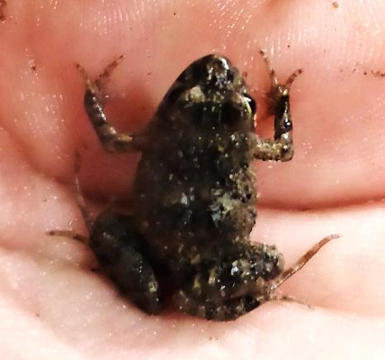
2.4 Wimmera frogs on-line
The Frogs of Australia website includes the Wimmera in their group of thirteen* “Frogs of the Grampians and Central West” at https://frogs.org.au/frogs/ofVic/Grampians_and_Central_West .
Each frog has its:
common name (use the alternative names list in section 2.1)
scientific name and group
photo
maps showing extent in Australia
and a link to a detailed field guide with additional information:
  alternative names
  environments suited to eggs, tadpoles and adults
  male call described and audio record
  monthly life cycle diagram for eggs, tadpoles, calling males and breeding season.
  adult size
  descriptions of eggs, tadpoles and adults,
  detailed visible features used for identification in the frogs.org.au database.
n.b. * Peron’s tree-frog is not included in the Wimmera on this website, but it can be found at https://frogs.org.au/frogs/species/Litoria/peroni/
You may like to familiarise yourself with this Grampians and Central West Frogs webpage.
Common Eastern Froglet - Crinia signifera,
(Wimmera Frog Guide no. 3)
from Warracknabeal area,
May 2019, photo J. Clark

Slide 12
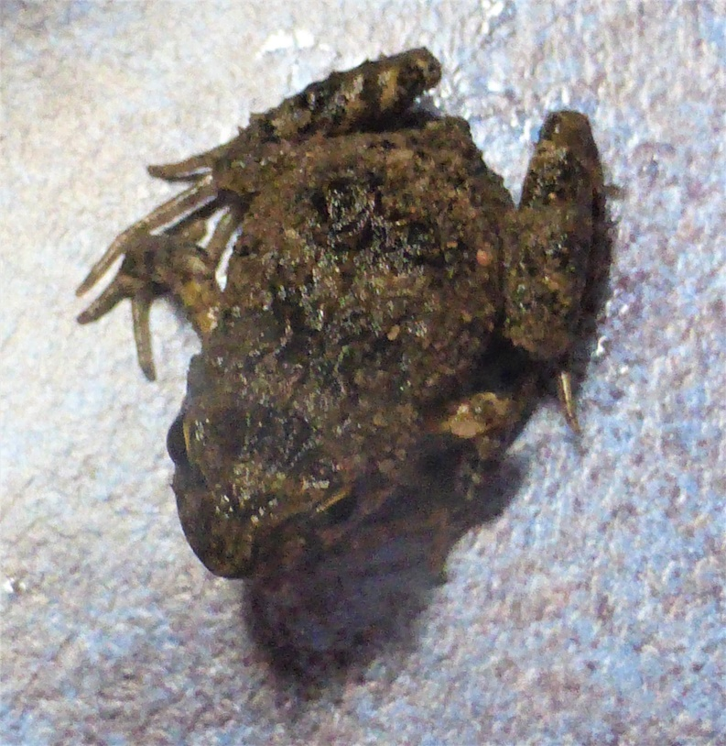
2.5 Key to identifying frogs
The Amphibian Research Centre’s frogs.org.au website includes an identification key for Victorian Frogs at http://frogs.org.au/frogs/key.html .
  Browse this key to see how it works:
The key goes through features, with photos of each a yes/no choice.
The presence/absence of a feature will lead to the next choice of question.
(So it helps to take photos of frogs from different angles, if you intend to identify them later, as this can be hard if you can’t see all the features in your photo).
For example, features begin with:
Question 1: Pads on the digits (fingers and toes) ?
Choice A – none (photo left)
This leads to the family level Myobatrachidae (Southern Frogs)
Question 1 : paratoid glands (skin gland on the neck)?
Choice A – present > Q2 metatarsal tubercles (lumps on feet)
Choice B – indistinct > Q3 orientation of the pupil (horiz/vert)
And so on, to reach genus and then species identification levels.
The Wimmera Frog Guide has other identifying features to confirm an identification.

Slide 13
Frogs of the Wimmera
Integrating frog education into your River Detectives Program
3 On being a frog

Slide 14
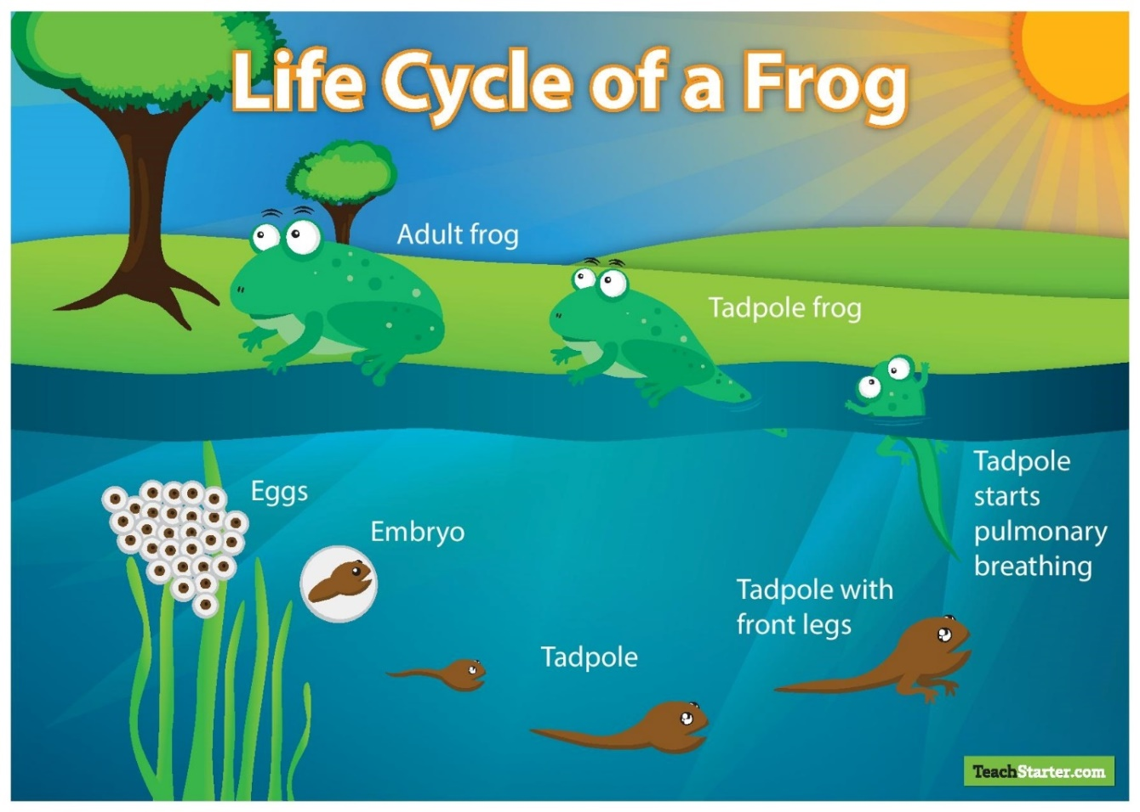
3.1 The frog life cycle
This life cycle of frogs is the same for all species, but the time frame varies.
Watch “From egg to frog in 7 weeks” at https://www.youtube.com/watch?v=wAcwjWi6I9Y
-a wonderful nature video (7 minutes) of this life cycle.

Slide 15
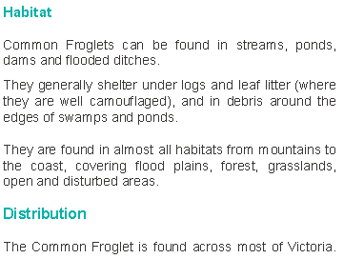
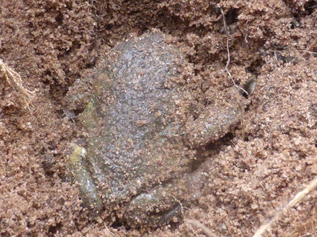
3.2 Frog habitats
  Common Eastern Froglet - Crinia signifera - Diet- small insects; Habitat needs:
  Source: “Our Wildlife Fact Sheet- Common Froglet” Vic DELWP, at
  https://www.wildlife.vic.gov.au/__data/assets/pdf_file/0021/91641/Common-Froglet.pdf
  Each frog species has specific habitat needs for:
  shelter
  food
  calling
  egg-laying
  The Guide to Wimmera Frogs book identifies five habitats from which frogs prefer to call. These are shown as a symbol on the top right hand corner of the right hand pages for each species:
    Terrestrial – from a nest or burrow
    Floating- while floating in open water
    Low arboreal – from grass or other plants
    Waters edge - in water or on the banks
    Aquatic – from water plants
  From which of the five habitat types would you expect this frog to do its calling?
.
Notes:
This frog uses a terrestrial habitat for calling.

Slide 16
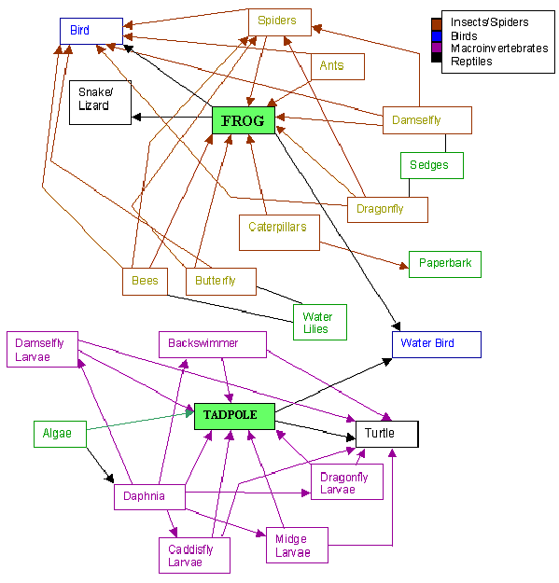
3.3 Frogs’ place in the environment
  Frogs live everywhere on Earth (except Antarctica and Greenland) in a variety of :
  habitats: from trees and cliff faces to underground or near any sort of water.
  and bioregions: warm wet tropics, rainforests, deserts, alpine and coastal.
  But they do not exist alone. They are part of wider environments and their food webs:
  Tadpoles typically eat algae and water insects. Larger water creatures eat them.
  Frogs typically eat insects. Reptiles and birds eat them.
  Follow the linkages on the food web to the right, made by students studying a wetland at Newton Moore Senior High School, in Western Australia. Source : http://wetlands.newtonmooreshs.wa.edu.au/05_leapfrog/biotic/food_web.html
  Almost half of Australia’s frog species have become extinct since European settlement. Loss of habitat is a major cause.
  Why is this not just an issue of ‘frogs’?
Notes:
Tadpoles eat algae when they are small, and as they get bigger, other water plant matter and small insect larvae, especially mosquito larvae.
Reptiles and birds eat frogs.
There is a tropical wetland food web diagram at the Canberra and District Aquarium Society’s “WHO’s Eating Who? “webpage http://www.cdas.org.au/node/52. It shows prey-predator relationships in the water only.

Slide 17
3.4 Frog adaptations
Every species has adaptations that help it survive in its environment.
Frogs have many adaptations, e.g. their eyes (to see all around), strong legs (for jumping and swimming), skin ( for living in water and on land), colours (for camouflage). The differences that are used to help identify different species come from their different adaptations to the different habitats in which they live.
Watch this 3 minute video https://www.youtube.com/watch?v=4owaBoBdZgY “Frog adaptations”. It introduces the key adaptations of frogs : eyes, strong legs, webbed feet,
Watch this 4 minute ABC Nature video introducing frogs “All about frogs” https://education.abc.net.au/home#!/media/2519447/all-about-frogs Notice the features which are adaptations.
What is the advantage of a vertically or horizontally
orientated pupil? In general, species with horizontal pupils
are the hunted and those with vertical ones are the hunters!
(see “Pupil shape linked to animals’ place in ecological web’”
by Sarah Yang, in Berkeley News, Aug 7 2015, at
https://news.berkeley.edu/2015/08/07/pupil-shape-and-ecological-niche/
.
Notes:
This “Fantastic Frogs” video https://kids.sandiegozoo.org/videos/fantastic-frogs is about frogs in the San Diego Zoo and shows a range of species with their adaptations. Some have similar adaptations to Wimmera ones.

Slide 18
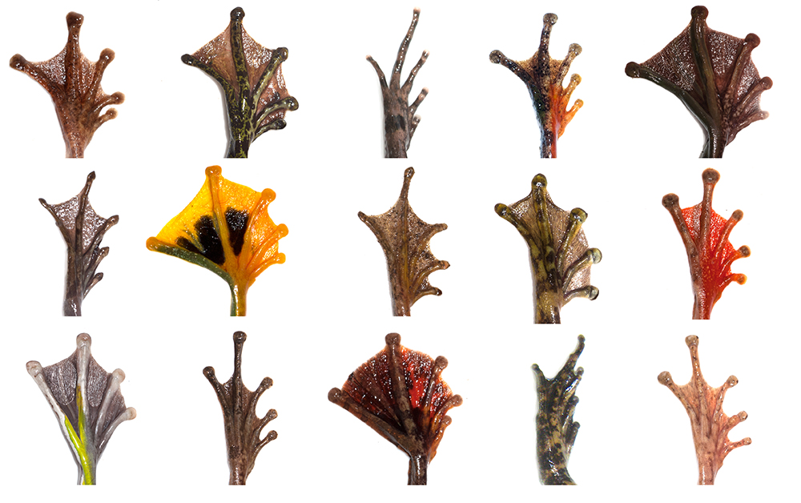
3.5 Frog feet adaptations
Many frogs that live in forests and rainforests have sticky toe discs to help:
them climb
and hold on to leaves and branches when resting.
Frogs that live in arid areas have tough tubercles (nodules, or lumps) on their back feet to help:
them dig into the earth when burrowing.
Frogs that live in water environments have webbed feet to help:
them swim more efficiently
Look at these fifteen different frog species feet. In what sort of habitat do you think each might live and why?
Source of photo right : Australian Geographic, ‘Best Foot Forward’ 2016, at https://www.australiangeographic.com.au/wp-content/uploads/2018/06/Best-foot-forward-frog-feet-ag130.jpg
.
Notes:
Toe-pads are for tree dwellers : photos 1,4,12,13,10,15
Toe-pads for hanging on in swift-flowing streams : photo 12
Webbed feet for swimmers : photos 2,6,8,9
Slender toes for forest floor dwellers : photos 3,14
Read more at “Best Foot Forward” in the Australian Geographic, March 14, 2016 at https://www.australiangeographic.com.au/topics/wildlife/2016/03/best-foot-forward/

Slide 19
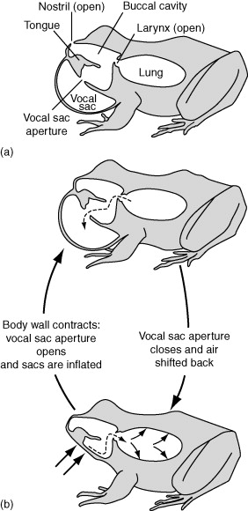
3.6 Frog calls
Most frogs can make a sound when there is danger:
when distressed
or under attack.
Frog calls, are sounds made by male frogs :
to attract a mate, or answer another frog call
often when rain is on it’s way, or after rain. (Why? A good time to mate!)
from vocal sacs under located under a male’s throat, as in the top diagram (a) to the right.
by air being pumped over the vocal cords between the lungs and vocal sac across the throat (in diagram (b)).
With a sound unique to each frog species. This makes it the most reliable way to identify frog species. (Watch and listen to this video of the range of frog calls from Coringa Swamp at Murrabit https://www.youtube.com/watch?v=o1rjGng5t2g )
tuned to the female frogs of that species, who return the call, and choose their mate, based on his call!
Diagram source: Figure 4 in Science Direct’s “Buccal Pumping’ at https://www.sciencedirect.com/topics/veterinary-science-and-veterinary-medicine/buccal-pumping

Slide 20
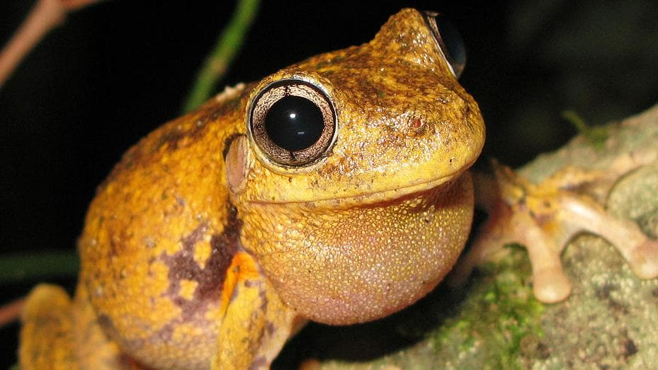
3.7 Wimmera Frog calls
BONK! BONK! BONK!
Do you know which frog produces this distinctive call?
Limniodynastes dumerlii- Pobblebonk, or Eastern Banjo Frog (no. 5 in the ‘Wimmera guide’).
What does it look like as it calls? This 1-minute video is of the Western Banjo Frog, in W. A.
https://www.youtube.com/watch?v=vbnQCPi7Exs
CRA-ah-ah-ah-ah-ah-ah-ah-ahk?
This is the call of frog 14 in the ‘Wimmera Guide’ –
Litoria peronii - Peron’s Tree Frog, is shown calling, to the right.
(Photo right by LiquidGhoul,
at https://en.wikipedia.org/wiki/Peron%27s_tree_frog#/media/File:Peron's_Tree_Frog_-_Litoria_peronii.jpg )
Frog calls are identified in the ‘Wimmera Guide’ in writing as well as on the DVD.
  (Get your copy from the Wimmera CMA, see slide 11.)
Calls the Wimmera’s frogs can also be heard on the web at:
  North Central Waterwatch’s “Frogs Field Guide” (only twelve are covered in this ) at http://www.nccma.vic.gov.au/sites/default/files/publications/frogs_field_guide.pdf)
  “Frogs of Australia” website , https://frogs.org.au/frogs/ , then choosing either to search by common or species name, or by going to the Victorian or regional (Grampians and Central West) guides, then choosing the ‘detailed field guide’ of the frog, and clicking on the calling button there.
  The Australian Museum’s “Australia’s Frogs” website , https://www.frogid.net.au/frogs , select the frog from the list of 240+ frogs, and scroll down the page to click on recorded ‘calls’ , in the section below the photos.

Slide 21
Frogs of the Wimmera
Integrating frog education into your River Detectives Program
4 Monitoring frogs

Slide 22
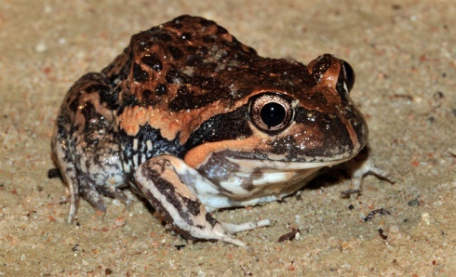
4.1 Why monitor frogs?
There are three key reasons to monitor frogs:
1 Frogs have an important role in food webs, as predators and prey.
  Frogs prey on insects and other invertebrates (animals without a backbone),
  Fish, birds, snakes and other larger animals prey on frogs.
Frogs are great biological indicators of environmental health.
  As frog skin absorbs oxygen from water, they are exposed to what is in the water, especially toxins and water pollution.
  Frog numbers decline with poorer water quality.
  Monitoring frog numbers reflects the health of the water (which can also be monitored).
  Changes in frogs reflect changes in environmental health.
  Because frogs are monitored by their calls, our attention to, and
  appreciation of, the complexities of Nature and an environment are
  widened by this. For example, noticing that a Pobblebonk/Eastern Banjo
  Frog (photo right), only calls after rain, but would be present at other times.
(Pobblebonk photo by Matt Lancy at https://wildambienceassets.s3.amazonaws.com/wp-content/uploads/2017/09/19165504/Limnodynastes_dumerili1.jpg )

Slide 23
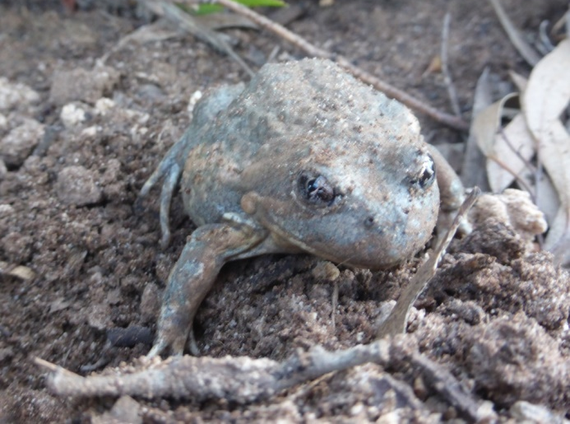
4.2 How to monitor frogs
Frogs are mainly monitored by their distinctive calls by:
listening for frog calls, especially at dusk or night time, when they are more vocal ( but some do call during the daylight).
  These can be recorded on a mobile phone.
knowing the calling season for frog species, (so as to limit those that one might identify wrongly). These can be found in frog identification guides.
returning to the same monitoring site repeatedly, so that changes in frog populations and their habitats can be discovered over time.
monitoring other aspects of those environments, so that there is data on any other water quality or habitat change in that frog habitat, e.g. through River Detectives.
What frog is here?
You don’t have to see a frog to monitor/identify it with Museum Australia’s FrogID app. If you can hear the frog, you can make a recording on your mobile phone. That can be linked to the FrogID app which will match the sound and give the identification.
… See the next section.

Slide 24
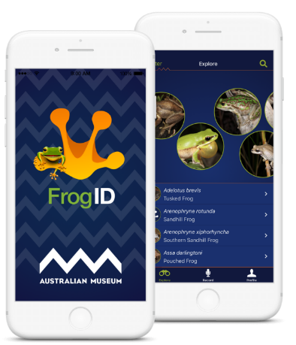
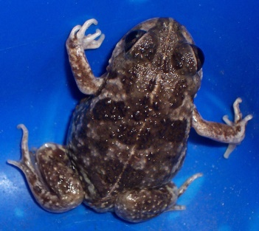
4.3 Monitoring with the FrogID app
“FrogID” is a Museum Australia app at https://www.frogid.net.au/ .
It enables the identification of a frog species from the recording that has been made on a mobile phone.
Once the identification is made, it is added to the validated records of frog species, numbers and locations.
This data can also be used to research frogs at https://portal.frogid.net.au/explore
Follow this example using the Painted Frog (photo right)
Go to https://portal.frogid.net.au/explore .
Enter ‘Painted Frog’ in the ‘search for species’ box.
The name comes with an arrow – click on it to hear its call.
The map changes to show their distribution , e.g. in Western Victoria
Repeatedly enlarge the map by clicking on it or the ‘+’ sign until you see individual dots of locations, e.g. in the Wimmera near Edenhope
Now click on the dot until a box appears. It has the date the record was made, e.g. 9 July 2018, and a link to the frog’s profile.
Click on the profile to get information on its conservation status, calling period, description, breeding, similar species, photos, calls and summary distribution map.
Notes:
Frog in this example was photographed by J. Clark in 2004

Slide 25
Frogs of the Wimmera
Integrating frog education into your River Detectives Program
5 Frog education in River Detectives

Slide 26
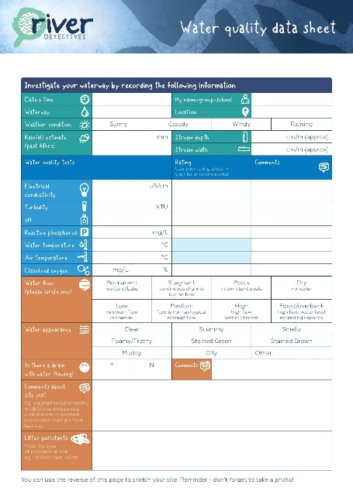
5.1 Monitoring frogs
Do you hear frogs when monitoring your RD site?
It is very easy to add listening for frogs to your RD monitoring, especially if you know how to identify frogs and/or tadpoles. (The guides in 2.1, 2.3 and 4.3 can be used to help with the identifications.)
Use of the River Detectives Water quality data sheet (photo right) provides detailed information about water quality and environment at a site.
Frog/tadpole information could be recorded in the ‘Comments’ section – second row from the bottom. Such Information could be: species, numbers, where eggs laid/tadpoles present, when found, and food supplies.
As described in section 4, monitoring of frogs is an important indicator of a site’s environmental health.

Slide 27
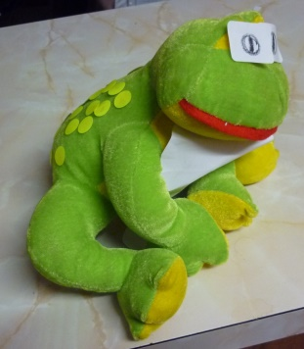
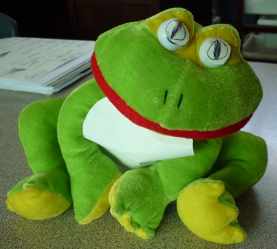
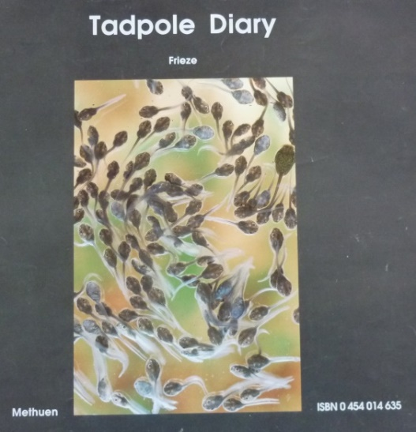
5.2 Getting to know frogs
Some suggestions for getting to know frogs:
Activities to identify a frog species (e.g. top photos).
Draw and label a frog, e.g. with help from https://johnmuirlaws.com/how-to-draw-frogs/
Create your own 3D frog, e.g. from playdoh
Record your frog sounds on the FrogID App. (see Section 4.3)
Name the life stages with this Melbourne Water frog work sheet https://www.riverdetectives.net.au/wp-content/uploads/2020/04/Frog-lifecycle-activity-sheet.pdf
David Drew’s Tadpole Diary (1987, Methuen) is a big book of fantastic photos of growing tadpoles, with a teaching kit, downloadable from the web.
The Australian Museum Schools webpage has many classroom resources for: diversity, identification, habitats, adaptations, life cycles, frog ponds, and habitats at https://www.frogid.net.au/schools
Modify a frog toy to add key features of a (local) species, e.g. vertical pupils, white belly and warty back of a Mallee Spadefoot

Slide 28
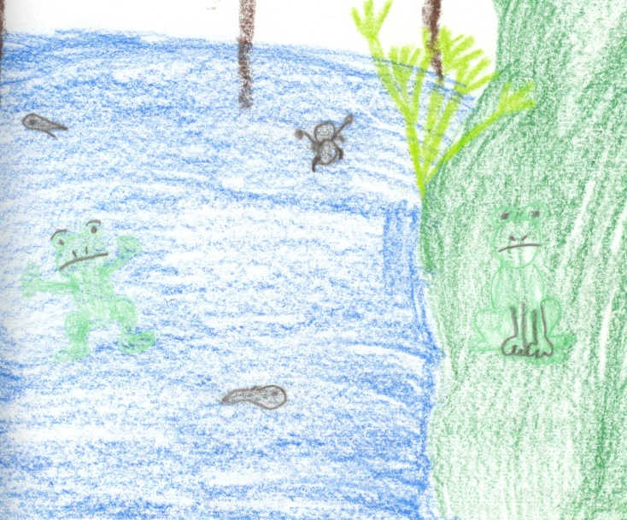
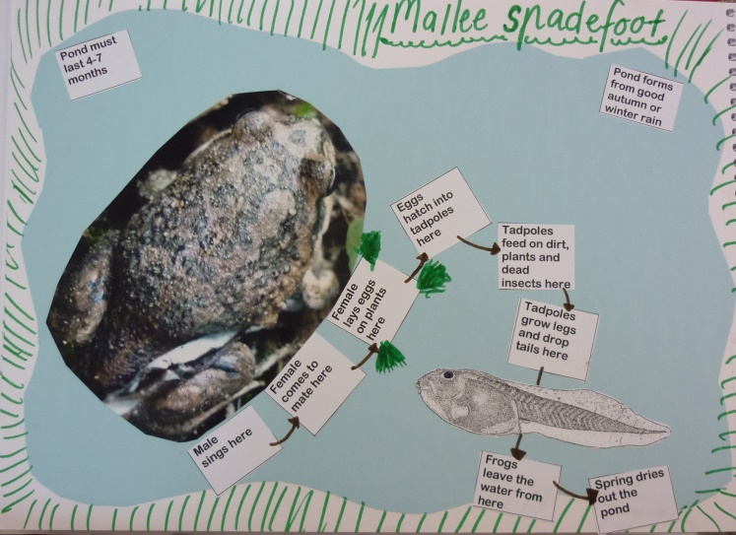
5.3 Sharing frog information
Great! You’ve found frogs/tadpoles present at your River Detectives site! What could you do to share that?
Add your frog identification records to the Australia Museum’s FrogID db, especially during FrogID Week (6-15 November,2020) . See details at https://portal.frogid.net.au/frog-id-week .
Use your frog calling recordings in practical ways, e.g. a ring tone on a phone, a school ‘bell’.
Make drawings based on your RD site (top photo) – then add labels for where the frog species might be during the day/night, lay eggs, tadpoles could grow and what food tadpoles and frogs have in the area.
Research the frog habitat needed by a frog –and make labelled drawings of it and what happens in it during the year (e.g. bottom photo right)
Create projects to promote local frog awareness, e.g. news article for the school newsletter; information poster for your local show.

Slide 29
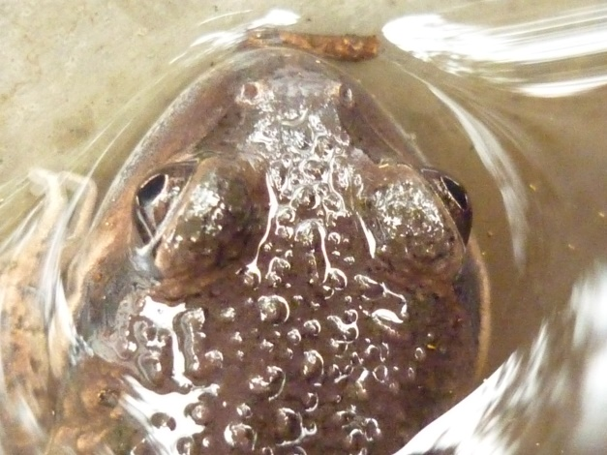
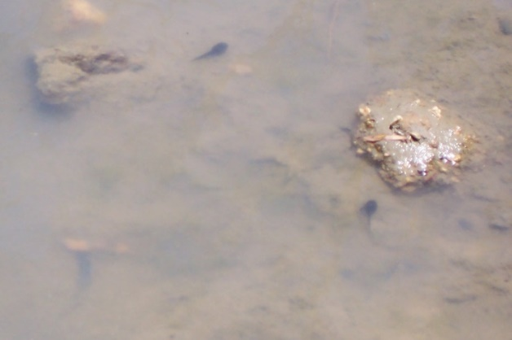
5.4 Frogs in the classroom?
It is a great experience to raise any living thing to be an adult – plant or animal! (See section 3.1).
But can you take eggs, tadpoles or frogs from your RD site? NO, not to your classroom, school pond or home garden.
However, you can create spaces to encourage frogs to come to, and if they do come, you can have them there to thrive. But, in Australia, it is illegal to collect wild frogs at any stage in their life cycle.
So if you want to see real frogs develop in your classroom, what should you do?
1 Contact DELWP for a licence (https://www.wildlife.vic.gov.au/keeping-and-trading-wildlife/wildlife-in-schools ).
2 Purchase a tadpole kit from the Amphibian Research Centre (https://frogs.org.au/arc/frogs.html )
Do not take me from my home!

Slide 30
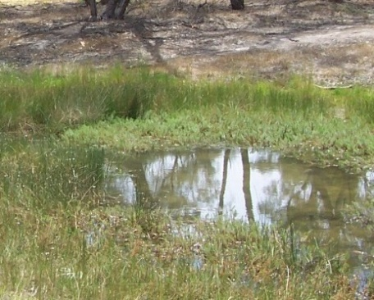
5.5 Encouraging frogs to thrive.
Basically what frogs need are water places with water plants. You could create frog-friendly habitats by :
improving the environmental health of a frog place (e.g. photo right)
especially at or near your RD site.
adding frog friendly plants to a part of your garden
creating a frog water place (frog pond, frog-bog or frog hotel)
Some suggestions for creating garden spaces to suit frogs can be found on the web, e.g.:
. Land for Wildlife’s “Creating frog-friendly habitats” at https://www.lfwseq.org.au/creating-frog-friendly-habitats/
Australian Geographic’s “ How to make your backyard frog-friendly” at https://www.australiangeographic.com.au/topics/wildlife/2018/01/how-to-make-your-backyard-frog-friendly/
Melbourne Water’s “Frog-friendly habitat –guide” found in the page at https://www.melbournewater.com.au/water-data-and-education/learning-resources/browse-resources-year-level/creating-frog-friendly

Slide 31
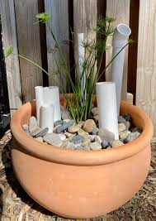
5.6 Create frog water homes
The decline in frogs has led to a National Frog Pond Building Project led by the Australian Museum and Bunnings (see https://portal.frogid.net.au/schools ) to encourage schools to build frog water places (ponds, bogs and hotels) where frogs and tadpoles can thrive. Instructions for building these can be found on the web:
The Garden Gurus TV ‘Build a frogpond for under $100 (WA)’ (2-minute video) at https://www.youtube.com/watch?v=VrVCPUhRLDo
Gardening Australia’s ‘How to create a frog bog habitat’ with Costa (10- minute video ) shows what needs to be considered to also make it safe in a school environment at https://www.youtube.com/watch?v=i2RN7gmW3NQ
Bunnings “How to build a frog pond” includes a materials list and their current cost at https://www.bunnings.com.au/diy-advice/outdoor/paths-and-landscaping/how-to-create-a-frog-pond .
Wildlife Preservation Society of Queensland ‘ Step-by-step guide to
building a frog hotel’ (photo right), includes keeping Cane Toads out
at https://wildlife.org.au/wp-content/uploads/2020/04/Step-by-step_guide_frog_hotel-1.pdf .
CREEC has a 5-step summary for building a DIY Frog Hotel at https://www.facebook.com/FriendsOfCreec/photos/a.417047315027952/3434434993289154/

Slide 32
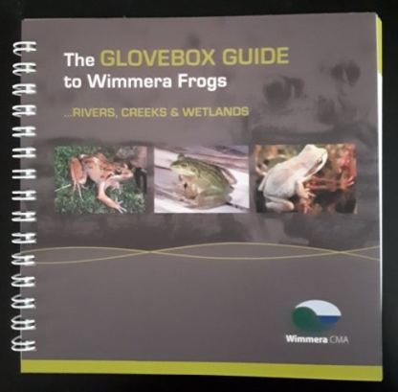
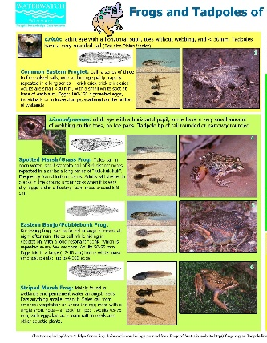
5.7 Key frog resources
River Detectives – search the resources section for relevant frog activities and resources
Wimmera CMA Glovebox Guide to Wetland Frogs - Detailed information about each frog found in the Wimmera, plus a CD of frog calls. Great for student research and use on site. You can visit/call the Wimmera CMA to obtain a free copy of the guide.
Waterwatch Frog & Tadpole ID charts – use these on-site to identify frogs and tadpoles (printable ID charts attached to the email with this PD)
Museum Australia – comprehensive, easy to follow, curriculum aligned frog education units. https://www.frogid.net.au/schools
Museum Australia Frog ID app (as already mentioned) – use this at your River Detective monitoring sites, or at school if you hear a frog call.

Slide 33
Frogs of the Wimmera
Integrating frog education into your River Detectives Program
5 Frog education evaluation

Slide 34
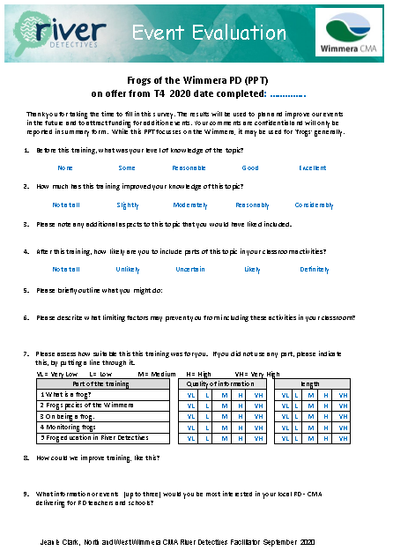

River Detectives, T4, 2020.
Frogs of the Wimmera
Professional Development
PPT session Evaluation
A DOCX copy of this form has been attached on this email for you. Please complete this and email it back to me.
Your feedback on this PPT PD is essential.
A PD certificate will be sent to you on my receipt of your evalution.
Thank you
Jeanie Clark
enviroed4all@skymesh.com.au
Ph 53941178

